Slide 1
Real Time Operating System Introduction & “FreeRTOS”

Slide 2
Agenda
RTOS Basics
RTOS sample State Machine
RTOS scheduling criteria
RTOS optimization criteria
Soft/Hard Real Time requirements
Tasks scheduling
Tasks priorities
Task State Machine
Periodic tasks
Tasks Blocking

Slide 3
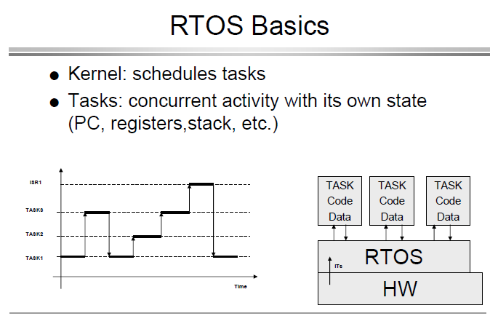

Slide 4
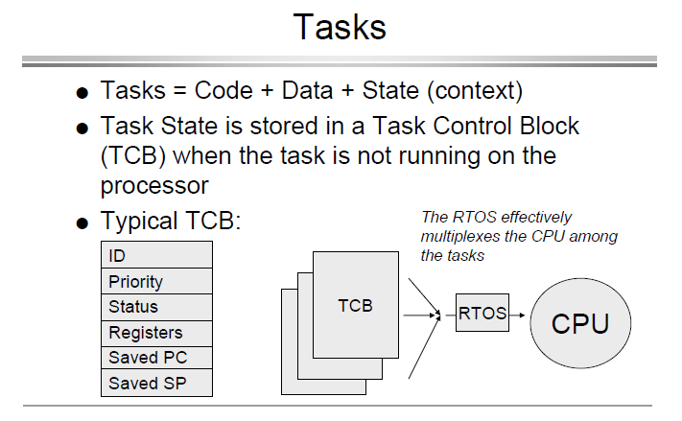

Slide 5
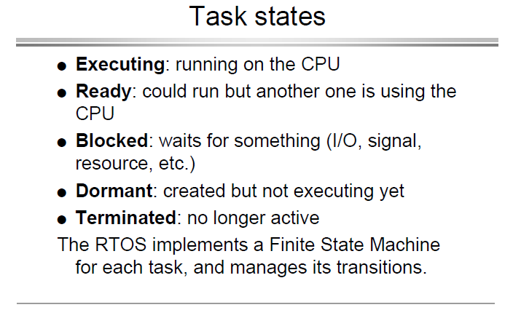

Slide 6
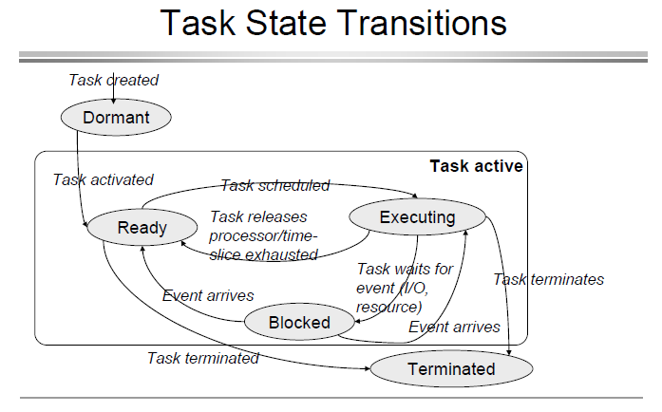

Slide 7
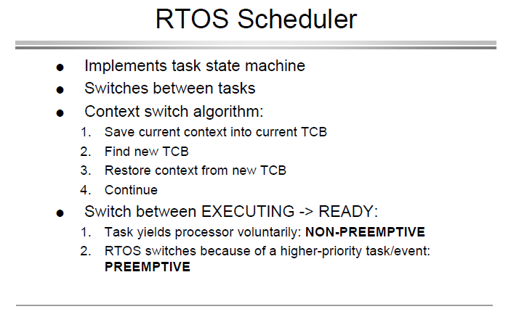

Slide 8
CPU Scheduling Criteria
CPU Utilization: CPU should be kept as busy as possible. (40 to 90 percent)
Throughput: Work is being done. No. Of processes per unit time
Turnaround time: For a particular process how long it takes to execute. (Interval between time of submission to time of completion)
Waiting time: Total time process spends in ready queue.
Response: First response of process after submission

Slide 9
Optimization criteria
It is desirable to
Maximize CPU utilization
Maximize throughput
Minimize turnaround time
Minimize start time
Minimize waiting time
Minimize response time
In most cases, we strive to optimize the average measure of each metric
In other cases, it is more important to optimize the minimum or maximum values rather than the average

Slide 10
Soft/Hard Real Time
Soft real-time requirements: state a time deadline—but breaching the deadline would not render the system useless.
Hard real-time requirements: state a time deadline—and breaching the deadline would result in absolute failure of the system.
Cortex-M4 has only one core executing a single Thread at a time.
The kernel decides which thread should be executing by examining the priority assigned to each thread by the application designer.
Application designer could assign higher priorities to hard-real-time-threads and lower priorities to soft real-time

Slide 11
Why Use a Real-time Kernel?
Abstracting away timing information
Maintainability/Reusability/Extensibility
Modularity
Team development
Improved efficiency (No Polling)
Idle time:
The Idle task is created automatically when the kernel is started. It executes whenever there are no application tasks wishing to execute. The idle task can be used to measure spare processing capacity, to perform background checks, or simply to place the processor into a low-power mode.
Flexible interrupt handling:
Interrupt handlers can be kept very short by deferring most of the required processing to handler RTOS tasks.

Slide 12
Task Functions
Arbitrary naming: Must return void: Must take a void pointer parameter:
Normally run forever within an infinite loop, and will not exit.
FreeRTOS tasks must not be allowed to return from their implementing function in any way—they must not contain a ‘return’ statement and must not be allowed to execute past the end of the function.
A single task function definition can be used to create any number of tasks—each created task being a separate execution instance with its own stack and its own copy of any automatic (stack) variables defined within the task itself.

Slide 13
Task Functions

Slide 14
Top Level Task States
When a task is in the Running state, the processor is executing its code.
When a task is in the Not Running state, the task is dormant, its status having been saved ready for it to resume execution the next time the scheduler decides it should enter the Running state.
When a task resumes execution, it does so from the instruction it was about to execute before it last left the Running state.

Slide 15
Creating Tasks The xTaskCreate() API Function

Slide 16
Example 1: Task Functions

Slide 17
Run Example 1

Slide 18
Task Creation After Schedule Started (From Within Another Task)

Slide 19
Example 2: Single Task Function “Instantiated Twice” (Two Task Instants)

Slide 20
Example 2: Single Task Function “Instantiated Twice” (Two Task Instants)

Slide 21
Task Priorities
The priority can be changed after the scheduler has been started by using the vTaskPrioritySet() API function.
The maximum number of priorities available is set by the application-defined configMAX_PRIORITIES compile time configuration constant within FreeRTOSConfig.h.
The higher the configMAX_PRIORITIES value the more RAM the kernel will consume, “keep it minimum”.
Low numeric priority values denote low-priority tasks, with priority 0 being the lowest priority possible.
Where more than one task of the same priority is able to run, the scheduler will transition each task into and out of the Running state, in turn.
Each such task executes for a ‘time slice‘; it enters the Running state at the start of the time slice and exits the Running state at the end of the time slice.

Slide 22
Task Priorities
To be able to select the next task to run, the scheduler itself must execute at the end of each time slice.
A periodic interrupt, called the tick interrupt, is used for this purpose.
The length of the time slice is effectively set by the tick interrupt frequency, which is configured by the configTICK_RATE_HZ compile time configuration constant in FreeRTOSConfig.h.

Slide 23
Task Priorities; Example 3: “Starvation”

Slide 24
Task Priorities; Example 3: “Starvation”

Slide 25
Task Priorities; Example 3

Slide 26
Task Priorities: Example 3; Starvation
Both Tasks are made periodic by the “dummy” loop
Both Tasks only needs CPU for short execution time!
Task 2 (High Priority) takes CPU all the time
Task 1 suffers starvation
Wastes power and cycles!
Is there another smarter way?

Slide 27
Expanding the ‘Not Running’ State
The Blocked State
A task that is waiting for an event is said to be in the ‘Blocked’ state, which is a sub-state of the Not Running state.
Tasks can enter the Blocked state to wait for two different types of event:
Temporal (time-related) events—the event being either a delay period expiring, or an absolute time being reached. For example, a task may enter the Blocked state to wait for 10 milliseconds to pass.
Synchronization events—where the events originate from another task or interrupt. For example, a task may enter the Blocked state to wait for data to arrive on a queue. Synchronization events cover a broad range of event types.

Slide 28
The Suspended State
‘Suspended’ is also a sub-state of Not Running.
Tasks in the Suspended state are not available to the scheduler.
The only way into the Suspended state is through a call to the vTaskSuspend() API function
the only way out being through a call to the vTaskResume() or xTaskResumeFromISR() API functions.
Most applications do not use the Suspended state.
The Ready State
Tasks that are in the Not Running state but are not Blocked or Suspended are said to be in the Ready state.
They are able to run, and therefore ‘ready’ to run, but their priorities are not qualifying to be in the Running state.

Slide 29
FreeRTOS Task SM

Slide 30
Using the Blocked state to create a delay
vTaskDelay() places the calling task into the Blocked state for a fixed number of tick interrupts.
While in the Blocked state the task does not use any processing time
vTaskDelay() API function is available only when. INCLUDE_vTaskDelay is set to 1 in FreeRTOSConfig.h
The constant portTICK_RATE_MS can be used to convert milliseconds into ticks.

Slide 31
Task Blocking: Example 4
Each time the tasks leave the Blocked state they execute for a fraction of a tick period before re-entering the Blocked state.
Most of the time there are no application tasks that are able to run; The idle task will run.
Idle task time is a measure of the spare processing capacity in the system.

Slide 32
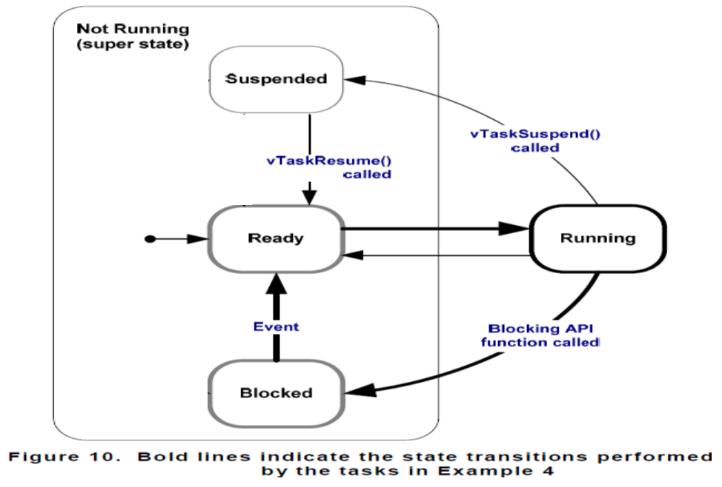
Task Blocking: Example 4

